Slide 1
Bubonic Plague-SMART
Ramsey Beilke, Jonathon Wenzel, Hailey Nuthals
MSOE, Dr. Colton

Slide 2
SMART Team
SMART
  Students
  Modeling
  A
  Research
  Topic
Goals-
  Understanding of the molecular world through the application of science in analyzing facts
  Modeling proteins to gain further information on their structural functions

Slide 3
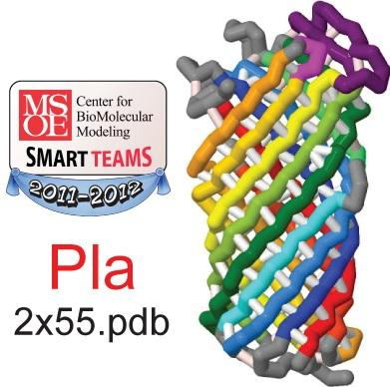

Slide 4
The PLA Protein and Bubonic Plague

Slide 5
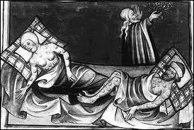
The Plague of History
First occurrence Byzantine Empire, ~500 AD
  25 million killed
Europe 1347, over one third of the population dead

Slide 6
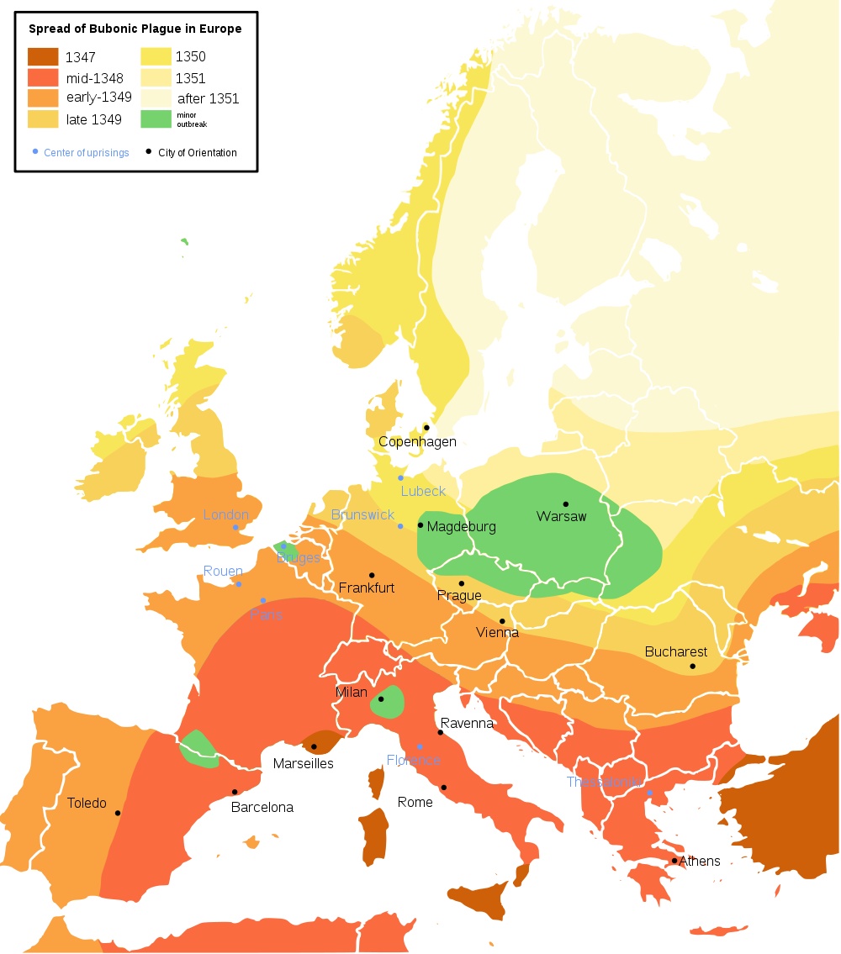

Slide 7
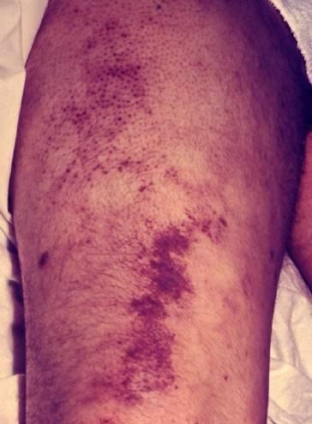
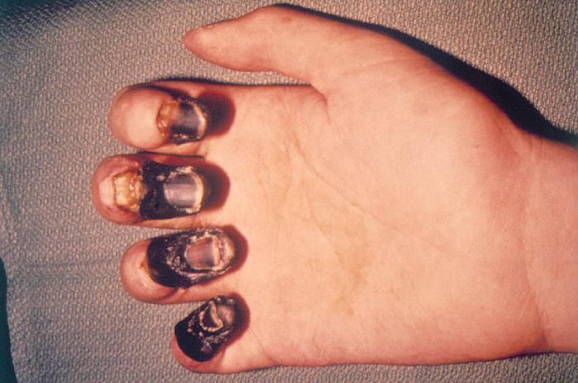
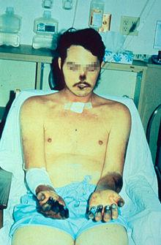
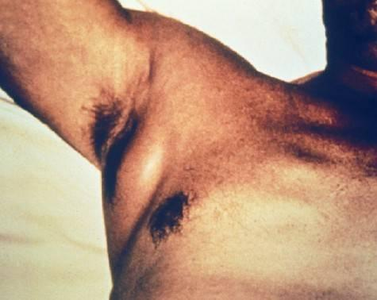
Pictures Of The Plague

Slide 8
The Modern Plague
The plague's true name is Yersinia pestis
Only about 10-15 cases per year in America
Roughly 1,000-3,000 cases worldwide

Slide 9
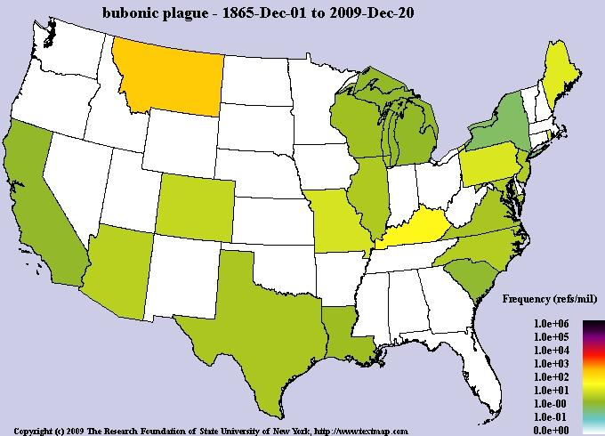

Slide 10
The Bacteria Up Close

Slide 11
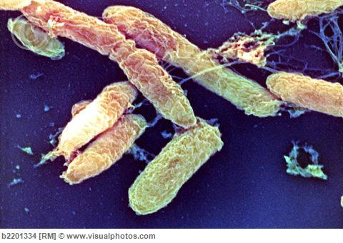
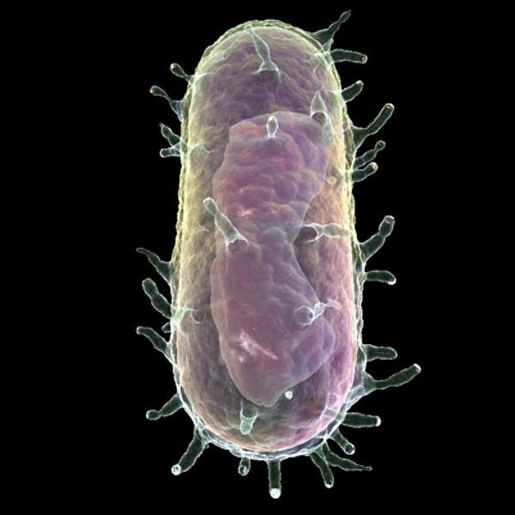
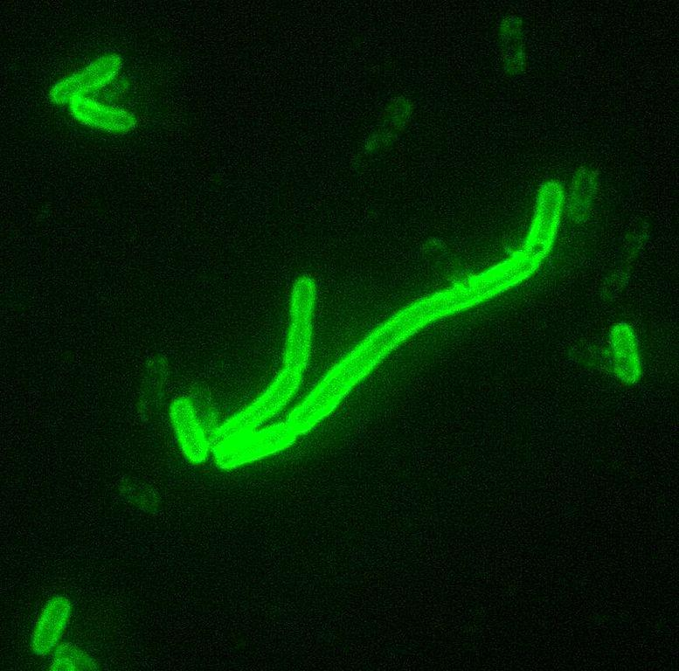

Slide 12
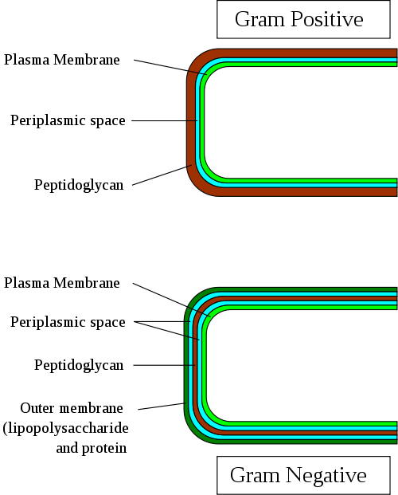
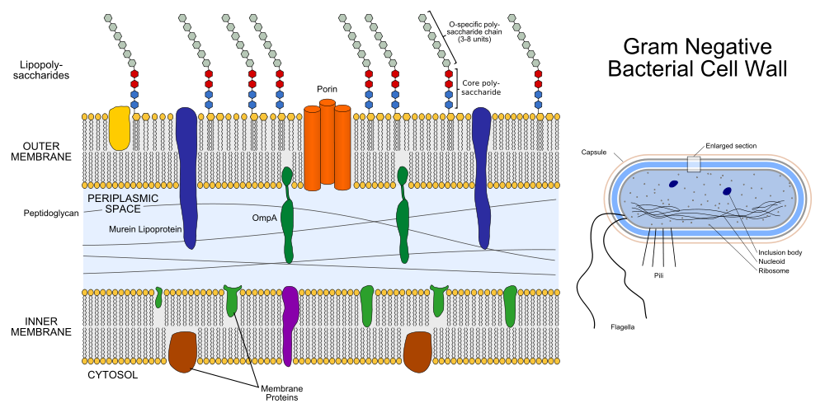
Gram Negative Bacteria
Gram Negative-multiple layers
Mainly affects lipopolysaccharide layer(LPS)
  Swelling

Slide 13
The Clotting Process
The body uses clotting to isolate bacteria
White blood cells can then destroy bacteria
Clotting uses fibrin
  Activated by Thrombin

Slide 14
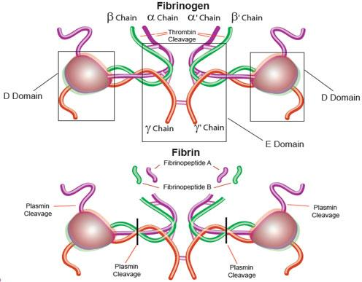

Slide 15
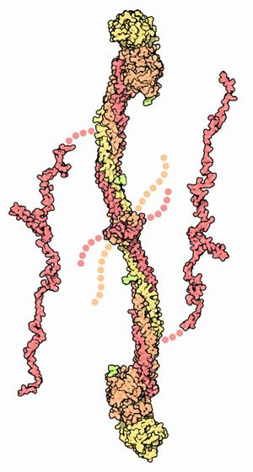
Fibrin/Fibrinogen

Slide 16
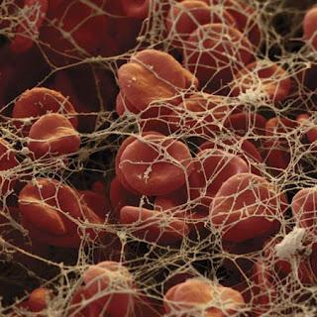

Slide 17
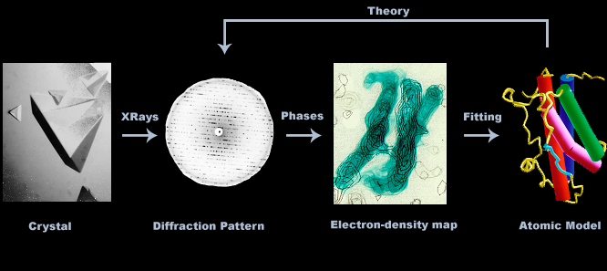
Crystallographic Action

Slide 18
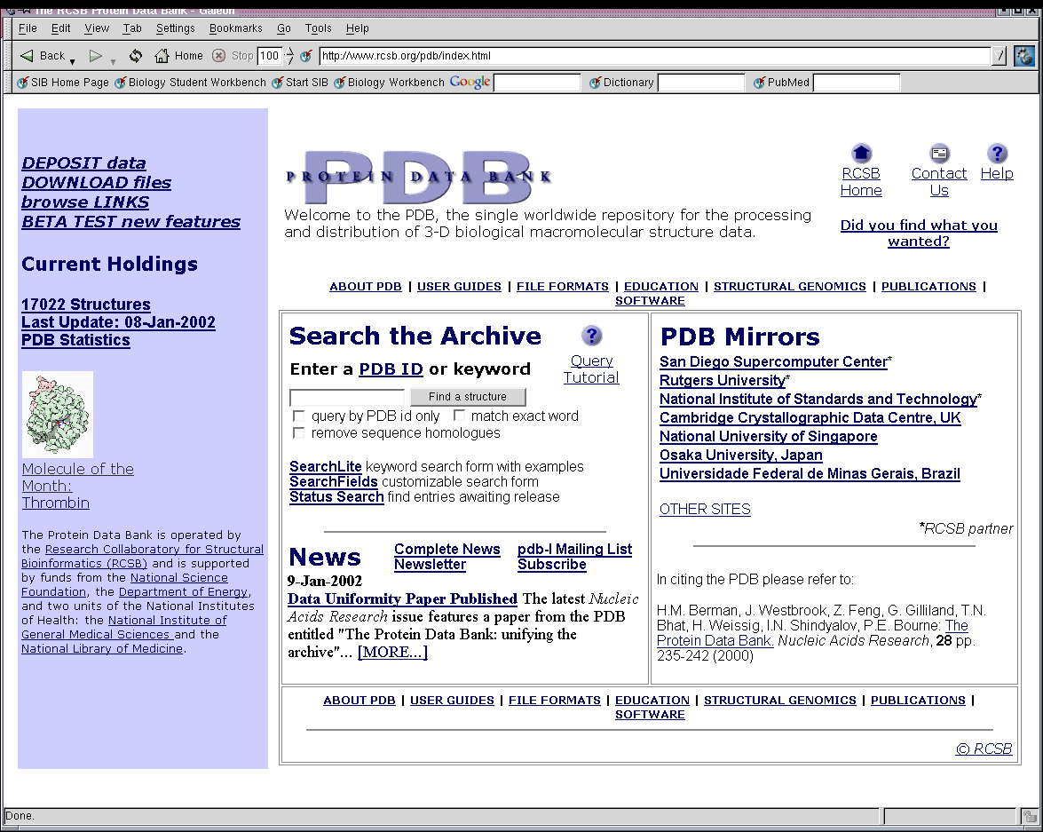
The Protein Data Bank

Slide 19

Jmol
Java program to edit and view molecular models
Used to help understand molecules and proteins
Able to shape model for use in helping others understand it as well

Slide 20
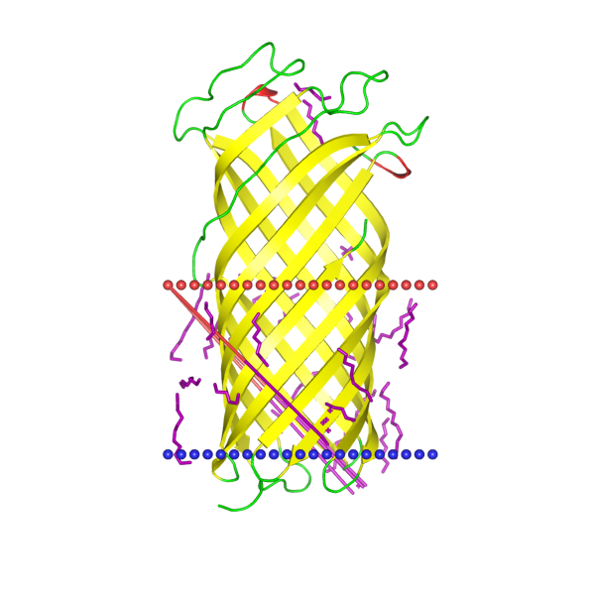
2x55.pdb

Slide 21
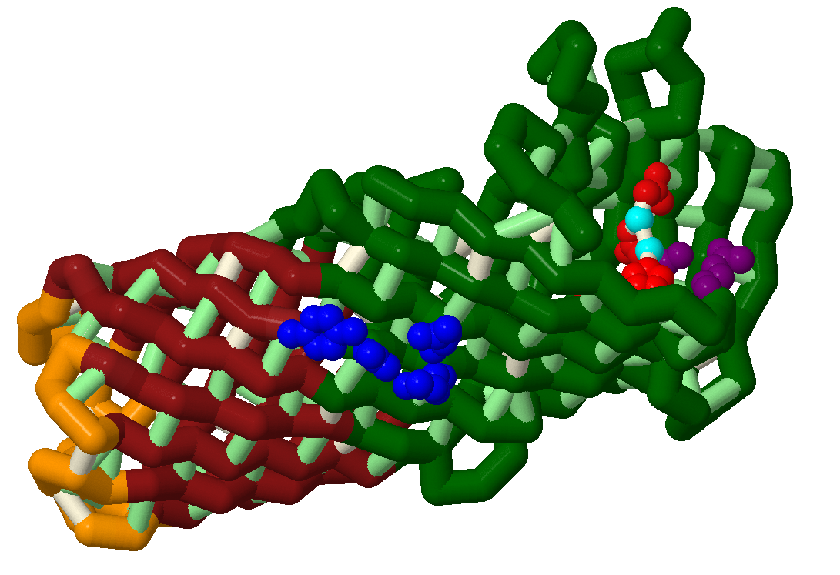
The PLA Protein

Slide 22
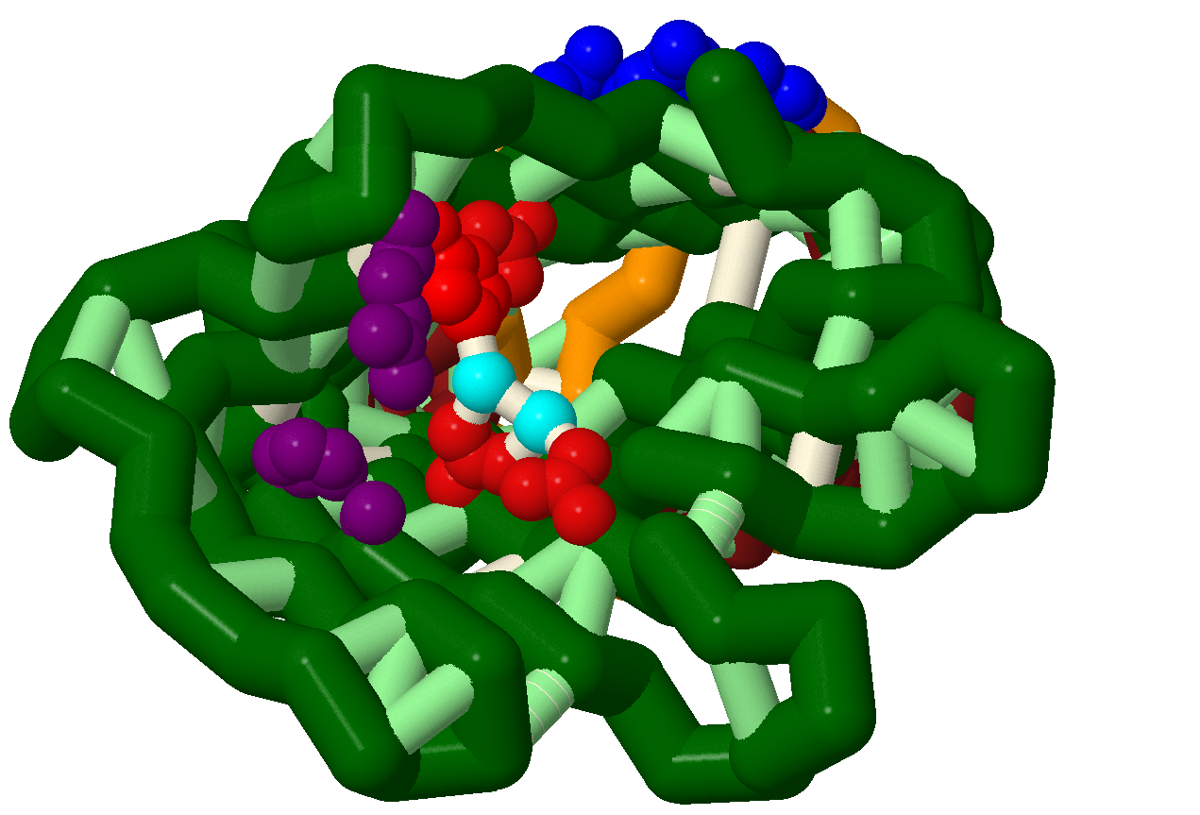
PLA's Active Site

Slide 23
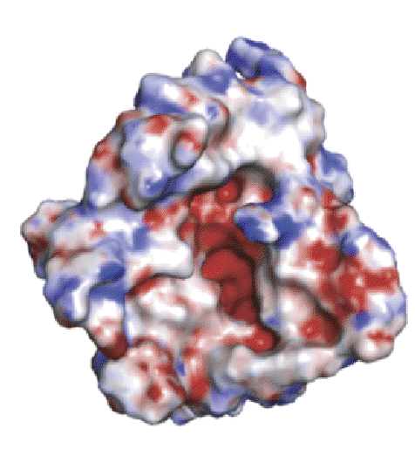

Slide 24
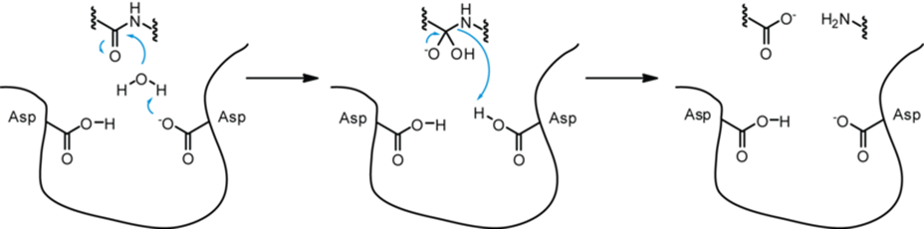
PLA Yersinia Pestis's Cleaver
Hydrophilic part of protein
"Cleaver" is an electrically excited water molecule

Slide 25
PLA- Antiplasmin's Worst Nightmare

Slide 26
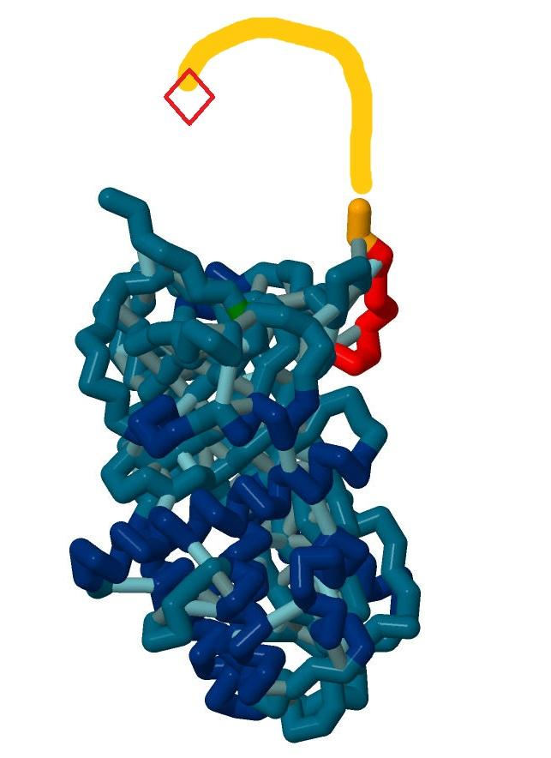
Alpha 2-Antiplasmin

Slide 27
How Antiplasmin Works
Antiplasmin inhibits plasmin, recycles it
The arm of antiplasmin "baits" plasmin
Attaches to plasmin and pulls it out of shape
Antiplasmin is used to maintain healthy levels of plasmin

Slide 28
Why Antiplasmin Is Relevant
Flea bites transfer Y. pestis
The open bite can be sealed by clots
Fibrin clots provide almost impenetrable barrier
Antiplasmin works to keep fibrin intact

Slide 29
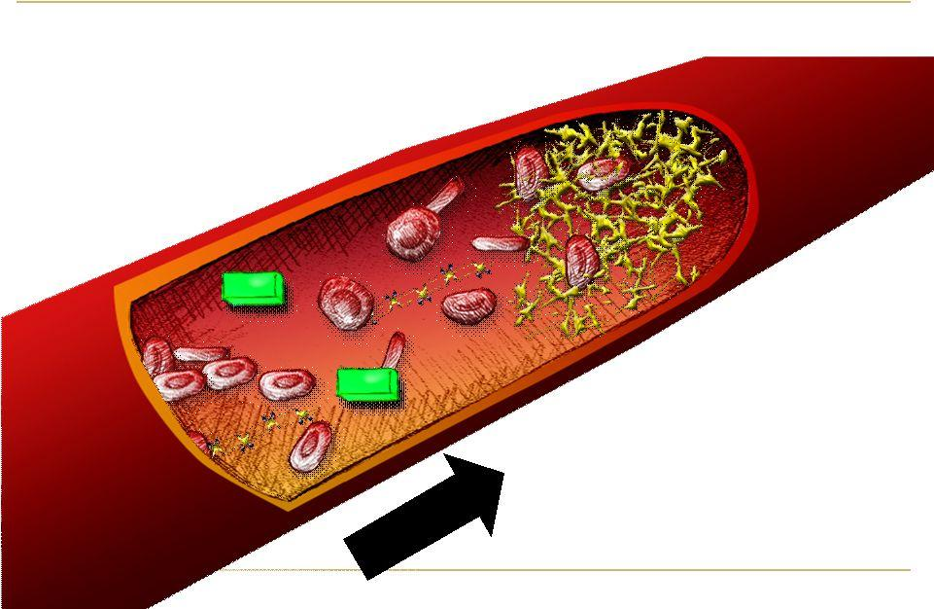

Slide 30
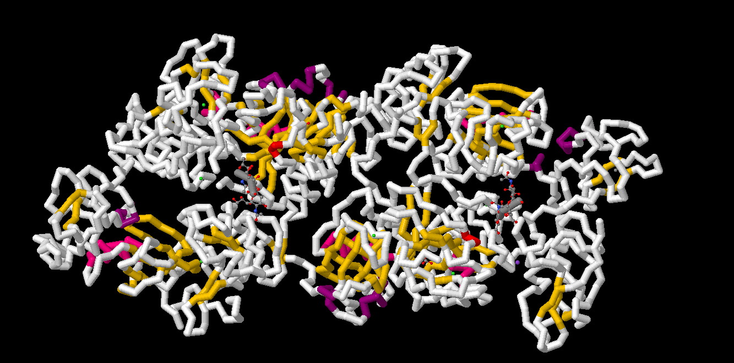
Plasminogen/Plasmin

Slide 31
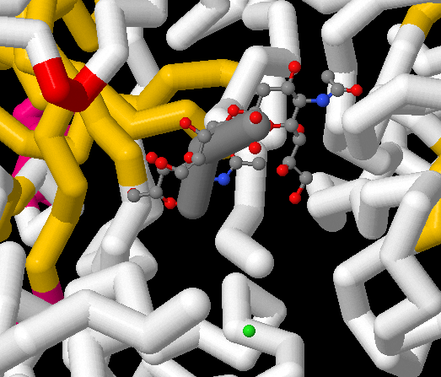

Slide 32
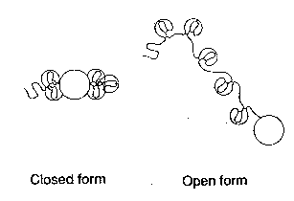

Slide 33
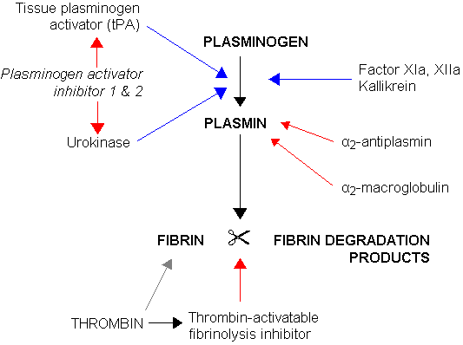

Slide 34
PLA's Purpose
The "cleaver" has 2 functions
  Cleaving the active arm in antiplasmin
  Cleaving the bond site in plasminogen
The combination provides for increased amounts of plasmin in the blood

Slide 35
Y. pestis and Plasmin
Increased plasmin leads to less fibrin and thus fewer clots
With no blood clots there is nothing to stop Y. pestis from entering the body
It can then spread unrestrained

Slide 36
Location, Location, Location
Bubonic Plague
  Lymphatic System
Pneumonic Plague
  Respiratory System
Septicemic Plague
  Blood Stream
Death within 2-4 days

Slide 37
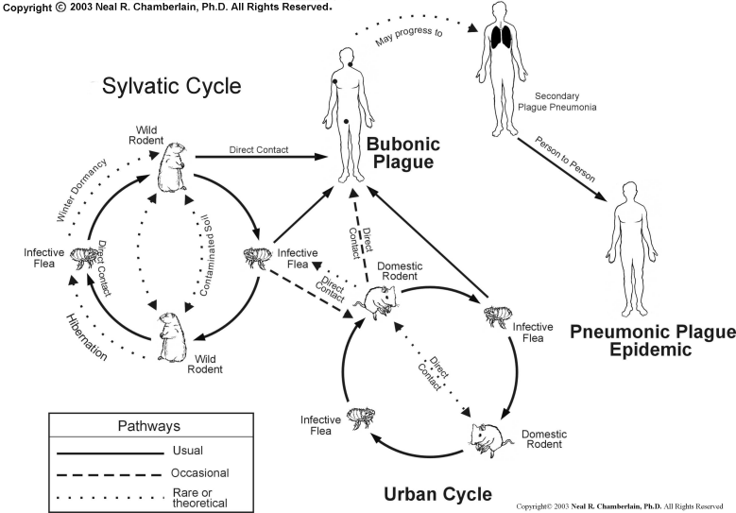

Slide 38
How It Kills
Inability to clot leads to inability to restrain it
  Body can not isolate bacteria
Bubonic form causes Lymphadenopathy
  Swollen lymph nodes
Septicemic form causes Disseminated intravascular coagulation(DIC)
  Small clots causes internal bleeding, destroys vital organs, fatal

Slide 39
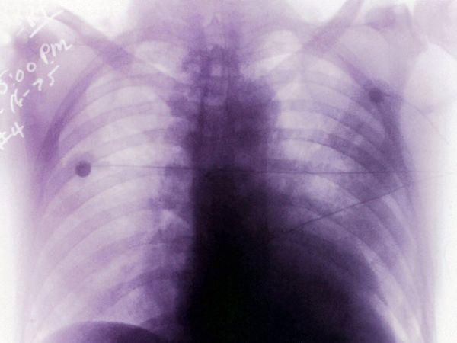

Slide 40
Sepsis
Unrestrained spreading results in lots of bacteria
Causes Sepsis, body-wide inflamation
Also known as blood poisoning

Slide 41
A More Detailed Look
Y. pestis produces F1 and V antigens to prevent Phagocytosis(absorbing into cell)
Resides in white blood cells as well as lymph nodes to "hide" from neutrophils

Slide 42
Possible Immunity
Vaccines to target F1 and V antigens
Allows white blood cells to target Y. pestis
Many new strains have altered antigens and are drug resistant

Slide 43
Significance

Slide 44
The Impact Of Plague
The plague can spread quickly and without immediate treatment can be deadly
Possible mutations could allow plague to resist antibiotics
Without knowledge of how the plague works, a second, more dangerous epidemic is likely

Slide 45
Biological Warfare
Earliest form of biological warfare
Easy terrorism weapon
  Causes an almost immediate epidemic
Drug resistance could make it deadly

Slide 46
Practical Applications
This cleaving reaction could be potentially used in many ways:
  Cleaning oil spills
  Better soaps
  Easier breakdown of trash/waste
  Possibility of reforming proteins
  Cancer treatment
New medicine, molecules

Slide 47
Bibliography
Goodsell, David. "Serpins." RCSB PDB-101. RCSB-PDB, 1 May 2004. Web. 02 Apr. 2012.
12. <http://en.wikipedia.org/wiki/Tissue_plasminogen_activator>.
http://www.rcsb.org/pdb/explore/explore.do?structureId=2x55<http://www.rcsb.org/pdb/101/motm.do?momID=53>.
"The Black Death: Bubonic Plague." Middle Ages. WideOpenDoors.net. Web. 01 May 2012. <http://www.themiddleages.net/plague.html>.
"Bubonic Plague." About.com Rare Diseases. Web. 02 May 2012. <http://rarediseases.about.com/cs/bubonicplague/a/111602.htm>.
"Oregon Public Broadcasting." Rare Case Of Bubonic Plague Shows Up In Lake County Â· OPB News. Web. 02 May 2012. <http://news.opb.org/article/rare-case-bubonic-plague-shows-lake-county/>.
"Man Diagnosed with Bubonic Plague in America's First Case of the 'Black Death' This Year."Mail Online. Web. 02 May 2012. <http://www.dailymail.co.uk/news/article-1385127/Man-diagnosed-bubonic-plague-Americas-case-year.html>.
"Fibrin." RCSB PDB-101. Web. 05 May 2012. <http://www.rcsb.org/pdb/101/motm.do?momID=83>.
"Thrombin." RCSB PDB-101. Web. 05 May 2012. <http://www.rcsb.org/pdb/101/motm.do?momID=25>.
"Tissue Plasminogen Activator." Wikipedia. Wikimedia Foundation, 05 May 2012. Web. 05 May 20
http://www.rcsb.org/pdb/education_discussion/molecule_of_the_month/images/83_1m1j-1fzc.jpg
http://content.edgar-online.com/edgar_conv_img/2008/03/07/0001193125-08-050184_G73520EXAS23GBGD.JPG
http://www.onlinemedicinetips.com/images/Where-Did-The-Black-Plague-Originate.jpg
http://hardinmd.lib.uiowa.edu/pictures22/cdc/PHIL_4139_lores.jpg
http://0.tqn.com/d/rarediseases/1/0/Z/7/ptarmg.jpg
http://upload.wikimedia.org/wikipedia/commons/thumb/0/0a/Acral_necrosis_due_to_bubonic_plague.jpg/220px-Acral_necrosis_due_to_bubonic_plague.jpg
http://www.unbc.ca/nlui/wildlife_diseases_bc/plague_cycles.gif
http://images.nationalgeographic.com/wpf/media-live/photos/000/094/cache/human-host_9446_600x450.jpg

Slide 48
Acknowledgments
Dr. Colton
  MSOE SMART Team Program
MSOE Center For BioMolecular Modeling
Mr. Heeren

